Slide 1
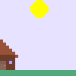
Pong 2.0

Slide 2
General Info
I made this game because of the first real program I ever made
This is for anyone who enjoys simple games

Slide 3
Usability Testing
Fixed bugs
Improved ball reflection
Changed score formula
Changed and limited speed increase
Made the game easier

Slide 4
History
Original project

